Slide 1
Vehicle Number Plate Validator Using Regular Expressions and DFA
BMS INSTITUTE OF TECHNOLOGY AND MANAGEMENT
Autonomous Institute under VTU, Belagavi, Karnataka - 590 018
Yelahanka, Bengaluru, Karnataka - 560 119
NAME USN
Abhishek Ireddy 1BY24CS400
Abhisheka AM 1BY24CS401
Aditya Mahekar 1BY24CS402
Arun Biradar 1BY24CS405
Under the Guidance of
Mrs. Manjula S D
Associate Professor

Slide 2
Introduction
Vehicle number plates in India follow strict standardized formats.
Manual checking of number plate format often leads to errors.
An automated solution is needed to validate number plates accurately before data is stored.
This project uses Regular Expressions (Regex) and DFA (Deterministic Finite Automata) to validate vehicle numbers.

Slide 3
Problem Context
Vehicle registration numbers are entered into databases for parking systems, toll systems, logistics, etc.
Incorrect formatting leads to:
Data inconsistency
Failed lookups
Wrong identity assignment
Security risks
Therefore, an automated validator is essential to ensure only correctly formatted number plates are accepted.

Slide 4
Indian Number Plate Format
Format: AA 00 AA 0000
State Code – 2 letters
District Code – 2 digits
Series – 1 or 2 letters
Vehicle Number – 4 digits
Example: KA05MH2456

Slide 5
Objectives
To design a system that automatically validates Indian vehicle number plates.
To understand and apply Regular Expressions for pattern matching.
To build a DFA that represents the structure of a valid number plate.
To visualize how each input character transitions between states in the DFA.
To create a user-friendly UI that shows:
Input processing
Current state
Acceptance/Rejection
Error highlighting
To ensure real-time validation with clear messages.

Slide 6
Supports Indian number plate format: KA01AB1234
Can be extended for multiple state codes.
Validates:
State codes
RTO codes
Series
Unique vehicle number
Does NOT handle detection from images (not ANPR).
Focus is on format validation, not recognition.

Slide 7
Workflow
User enters number
Regular Expression check
DFA checks character-by-character
Accept or Reject

Slide 8
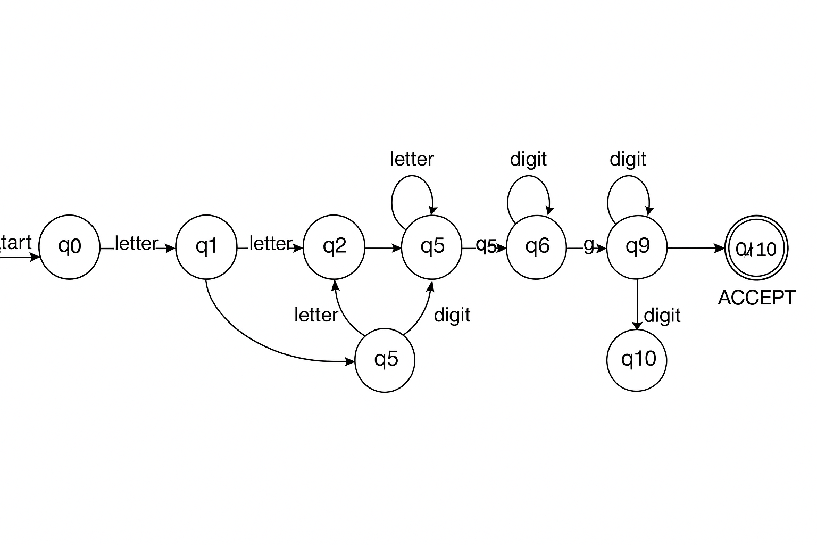
Flow Diagram

Slide 9
Indian Number Plate Format
Format: LL NN LL NNNN
Where:
Part | Meaning | Example
LL | State Code | KA
NN | RTO Code | 01
LL | Series | AB
NNNN | Vehicle Number | 1234

Slide 10
Real-World Applications
Toll Booth Systems
Traffic Surveillance Cameras
Smart Parking
Law Enforcement
Security Access Systems

Slide 11
Regular Expression Used
Pattern : ^[A-Z]{2}[0-9]{2}[A-Z]{1,2}[0-9]{4}$
Explanation:
[A-Z]{2} → Two uppercase letters (State code)
[0-9]{2} → Two digits (RTO code)
[A-Z]{1,2} → One or two letters (Series)
[0-9]{4} → Four digits (Unique Vehicle Number)

Slide 12
Conclusion
Successfully built a Vehicle Number Plate Validator using:
Regular Expressions
Deterministic Finite Automaton
System achieves high accuracy and simplifies validation.
Combines TOC concepts with practical web development.
Can be used by parking systems, toll systems, and government portals.

